Slide 1
How to ensure SOX, HIPAA, & GDPR compliance in Dev and Test
Notes:
Good Morning and Good Afternoon everyone and thank you for tuning in to today’s webinar.
First things first a bit of house keeping from our side, you will notice that you are muted for the duration of today’s webinar, however if you have any questions at any point please do feel free to log these in the little question box on the go to webinar popup and I’ll be more than happy to tackle these at the end of today’s session, you will also be sent a link to view the recording afterwards, so please no panicking if you miss even the tiniest shred of information today.

Slide 2


Your Presenter
Chris Unwin
Data Privacy Specialist
Chris.Unwin@red-gate.com
/in/christopherunwincambridge/
DBAle on Spotify and iTunes
Notes:
My name is Chris Unwin; Redgate employee of 3 years, Data Privacy Specialist, article writer and infamous co-host of the Redgate DBAle podcast, and I will be your host for today's webinar.

Slide 3
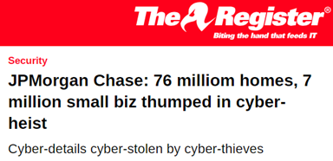
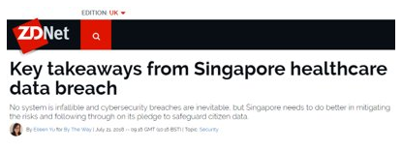
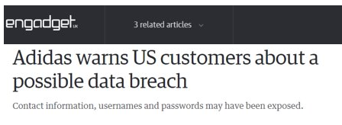
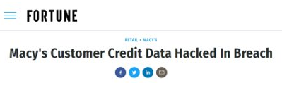
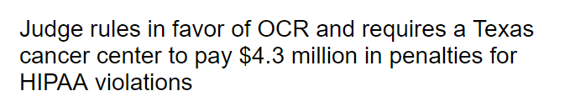
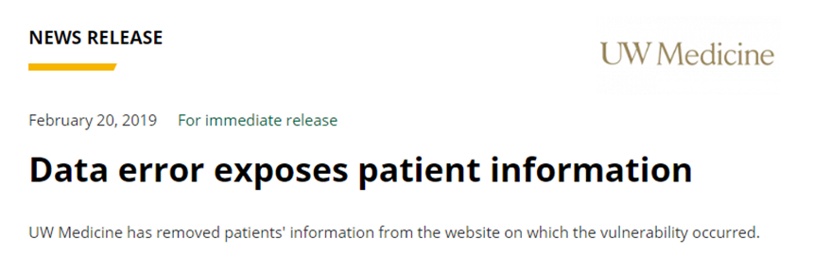
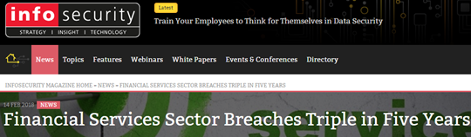
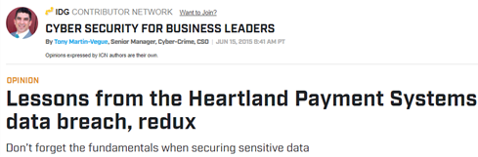
Notes:
[Where is a good place to start?]
Most recently, many data breaches have drawn the public eye, not least of these was Rubrik, an IT Security and Cloud Management company, who suffered a Database breach. The database itself, running on a hosted Amazon Elasticsearch server, was storing tens of gigabytes of data, including customer names, contact information and case work for each corporate customer, dating back to October 2018. Rubrik stated “While building a new solution for customer support, a sandbox environment containing a subset of our customer corporate contact information and support interaction data was potentially accessible for a brief period of time,” – Rubrik have resolved this issue and believe that no one did in fact access it whilst it was available.
We can take solace from that fact but it’s not always positive news. Many companies, including the National Bank of India, Marriott and others have felt the pain of exposing customer details and people taking advantage of this fact.
So where are these breaches coming from? How are they still happening?

Slide 4

Sources of breaches
Privilege misuse: 12%
Hacking: 48%
(Healthcare) Internal: 56%
(Finance) External: 92%
No. 1 asset involved: Database
*Study from 2018 Data Breach Investigations Report- Verizon
Notes:
Well it’s pretty clear that regardless of which industry or sector you’re in, they’re going to come from somewhere, and there are so many sources that a breach can come from.
As we just discussed about the state bank of India, financial institutions are being hammered constantly from all sides as the data that can potentially result from a breach can pay hackers in dividends.
Really, if attacks can come from anywhere at any time there’s really only one approach we can take and governments and organisations around the world will be keeping a watchful eye on this, as the privacy landscape of the world rapidly changes as 2019 storms ahead.

Slide 5
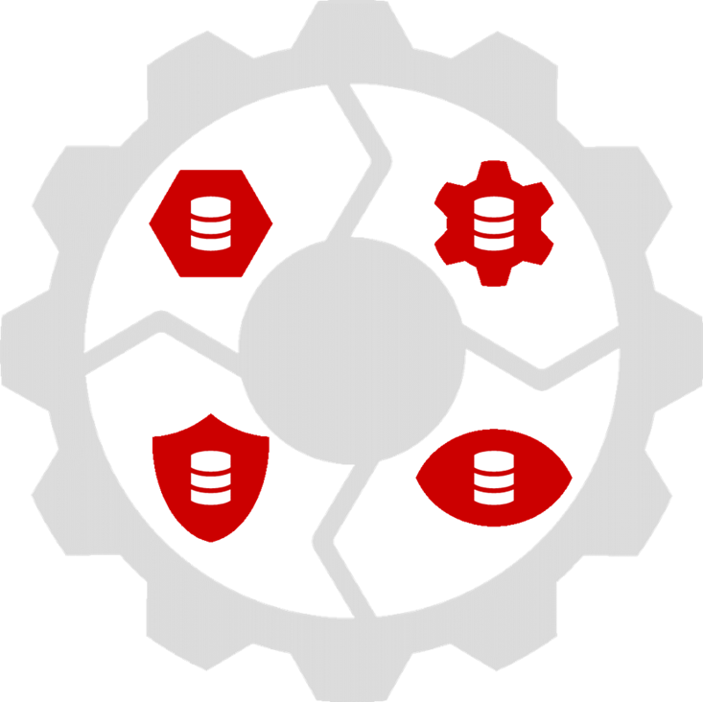
Privacy regulations around the world such as HIPAA, SOX, GDPR, CCPA, SHIELD etc. demand effective and repeatable processes for protecting sensitive data.
Or… Data Protection by Design and by Default.
Notes:
We can all agree, we should be protecting our customer data for the good of those who place their trust in us. But,
[Read Slide]
[Speak about protection by design and by default]
But what is the cost of non-compliance for some of these regulations?

Slide 6

Cost of non compliance
HIPAA: Up to$1.5m & 10 years in prison
SOX: Up to$5m & 20 years in prison
GDPR: Up to €20m or 4% of annual global turnover
POPI: Up to R10 million & 12 months in prison
PIPEDA: Up to $100,000
Notes:
But what impact can legislation have on companies? Well it's right before you. Fines and prison sentences can easily be levied for breaching the controls in place to protect this information. There are so many pieces of legislation that can be enforced where personally identifiable information is concerned, most notably in the US HIPAA and SOX (something that we at least have a history to pull from), and by looking down the list there are many cases that highlight just how much of an impact they can have.

Slide 7
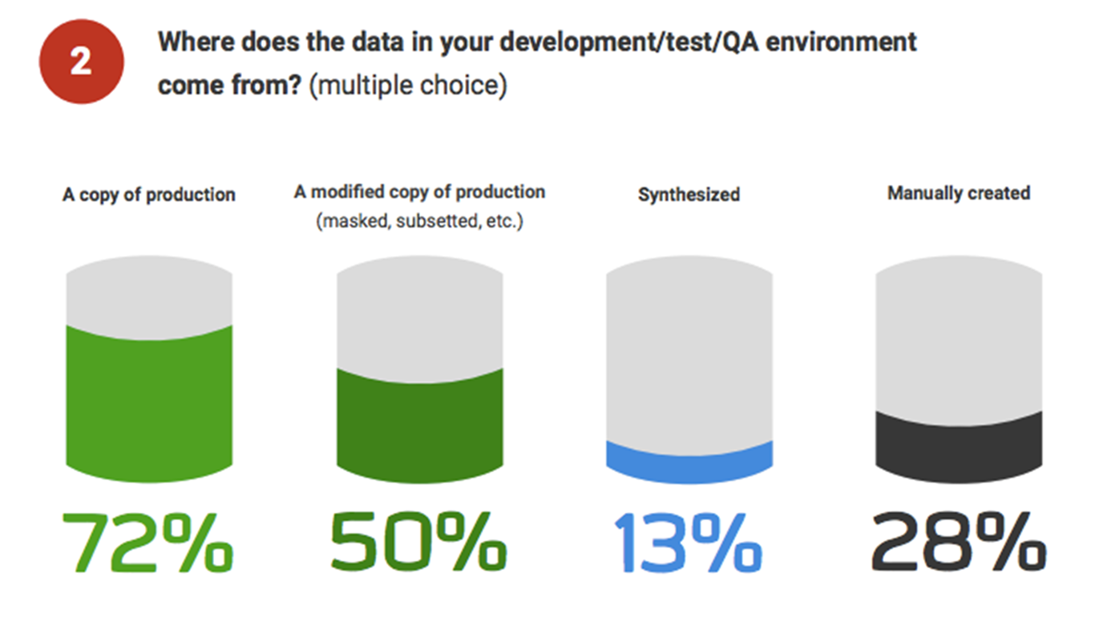
Most Organizations do ‘copy-down’ Live Data
Notes:
As we saw from Rubrik, and as we know from many others, it is this pre-production exposure of Production data that can form some of the greatest risk to our processes.
Well from the state of database Devops report 2019 carried out by RedGate, we know that most people are already using a copy down of Production into these environments, but we can all agree this should no longer be the case.

Slide 8
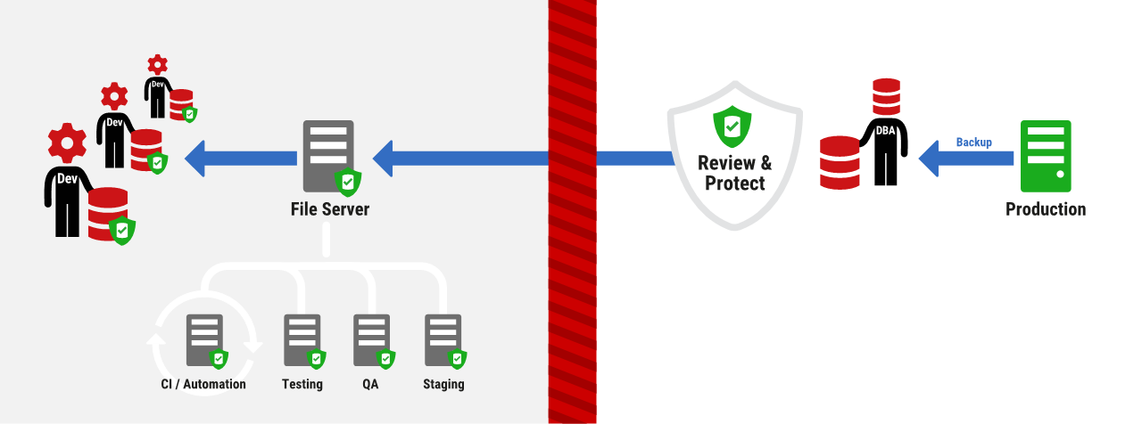
How can we stay compliant AND use production-like data?
Notes:
But there’s no simple answer to ensuring that our Dev & Test teams are easily enabled whilst ensuring we’re also protecting all of our data, or is there?
Redgate’s SQL Provision will allow us to do just that. Effectively we put in place a Data Firewall that allows us to copy down something that is like Production, still has the same look and feel but ultimately puts none of our data at risk.
As an added bonus, it utilizes the VHD technology present in 64-bit windows to allow us to create virtualized copies so not only do we remain compliant, but we rapidly deliver very tiny-imprint databases that can be dropped anywhere, like Dev machines, test servers, anywhere! And the whole process can be very easily managed.

Slide 9
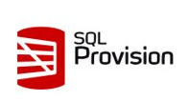
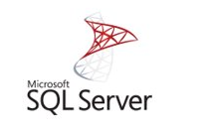
A small attack surface makes compliance easier
1TB
1TB
Prod
Prod
Vs
0TB
0TB
0TB
1TB
1TB
1TB
Dev
Test
QA
Dev
Test
QA
PII only in PROD
Lower risk
PII in all environments
Higher risk
Notes:
When there are fewer assets for us to worry about, even if there are vulnerabilities that can be exploited to gain access to the data in pre-production - because we have anonymized it, there exists a much smaller risk to our customers.
This is alongside the added benefits to us as a company that we can quickly spin up database Clones whether this is for dedicated, sandboxed development or more agile testing. SQL Provision enables Compliant Devops at each stage of the pipeline and lets us move value up to Production quickly.
In summary [next slide]

Slide 10
SQL Provision In Action

Slide 11
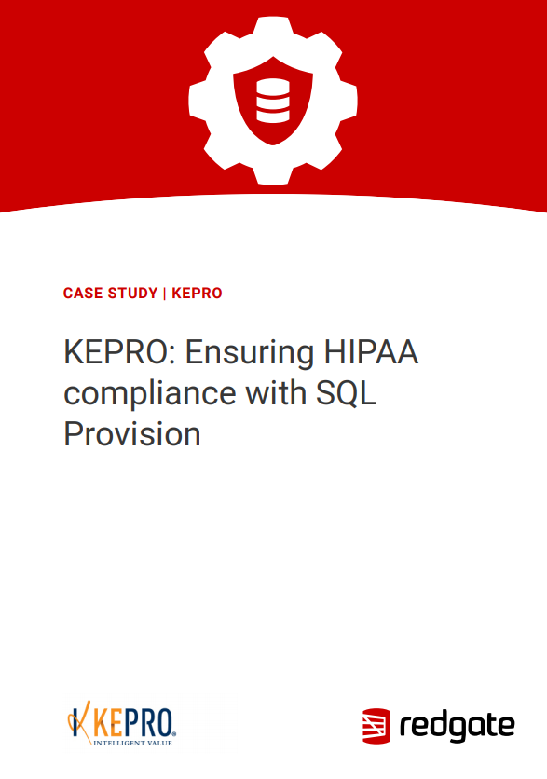
Case study
Masked PHI without jeopardizing data integrity
Supply realistic data for testing
New off-shore development team HIPAA compliant
Saving 15-20 hours a week in provisioning processes
Reclaimed terabytes of disk space

Slide 12
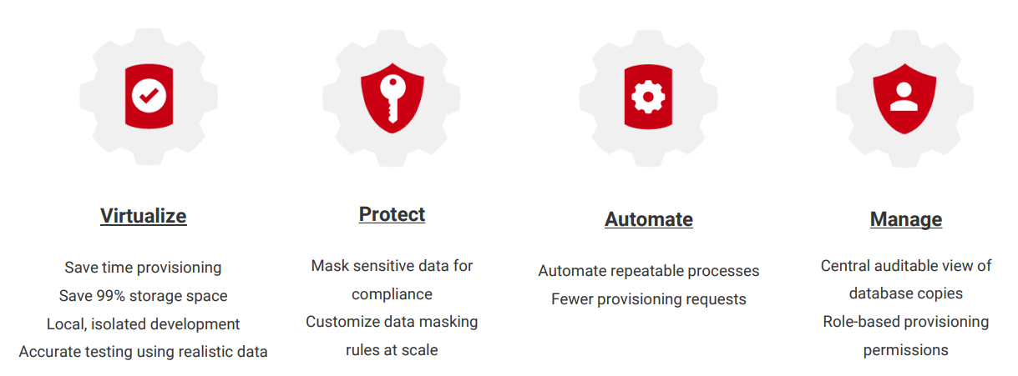
Benefits – recap
Notes:
So what does SQL Provision enable us to do?
[Talk through slide]

Slide 13
Q&A Session

Slide 14
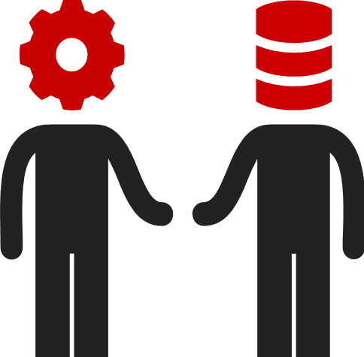
Next steps
Speak to us: SQLProvision@red-gate.com
Learn more: red-gate.com/sql-provision

